Slide 1
E-WASTE MANAGEMENT SYSTEM
Submitted by
RESHMI H L
PRAJITH M
GOUTHAM R
BLESSON SAJU
SACHIN TOM

Slide 2

RECYCLIA
Reuse the Past, Recycle the Present, Save the Future

Slide 3
Content
INTRODUCTION
EXISTING AND PROPOSED SYSTEM
STAKEHOLDERS
WORKFLOW
TABLES
CONCLUSION

Slide 4

INTRODUCTION

Slide 5
PROJECT OVERVIEW
The “RECYCLIA “is a Waste Management System, which present an admin-agency-customer interaction system based on Angular framework.
This application makes it possible for the customers to send request to the corresponding agency for the removal of e-waste while providing about the details of the waste item.
Agency can only accept request from the approved customers and can update the details of the e-waste after the removal.
The “Recyclia” helps the customer to view and buy recycled product from the portal.
Customers can also send complaints directly to the admin. Only admin can have the authority to solve the complaints.
This is an application for customers so that they can manage their e-waste from anywhere.

Slide 6
EXISTING SYSTEM
In the existing system there is no availability to ask request to throw out the garbage in their apartment.
It takes lot of time to throw garbage and more physical effort is needed.
Existing system is only available to specific apartment in a specific place.

Slide 7
PROPOSED SYSTEM
The proposed system provides an easy way to users where users can simply send a request to agency and give details of the garbage from anywhere and from anyplace.
Proposed system have the facility of selling recycled products to customer
The proposed system saves lot of time and no need of any physical effort.
Advantages Of Proposed System
Menu driven
Eliminates manual intervention as far as possible
Error free modification facilities

Slide 8
STAKEHOLDERS
ADMINISTRATOR
AGENCY
CUSTOMER

Slide 9
ADMINISTRATOR MODULE
Signup their account. Then Login (No approval Required).
Add/View/Update/Delete Agency details(Add agency as per the requirements)
View/Approve/Delete Customer details.(Confirm customers after checking their profiles)
View e-waste requests and updations. (Verify the customer requests and status of the request)
View/Solve complaints from customer side. ( Solve customer complaints directly)
Add/Update/Delete/View recycled product details. ( Add new products )
View user request for product and can confirm delivery. (Give confirmation for delivery)
Logout

Slide 10
AGENCY MODULE
Login to the account which was already created by the admin(No approval Required).
View their profile.
View their own customer's profile.(View only their customer details)
View/Update their customer e-waste request details.(can update only the request from their customer side)
View their customers complaint and status(only view their customer request and status)
View recycled product details.(View the list of products added by the admin)
Logout

Slide 11
CUSTOMER MODULE
Signup an account and then login (Approval is required from admin side in order to login)
View/Edit their profile.
View their own agency's profile.(View only their agency profile)
Send e-waste request,Cancel request and view the updations from the agency side. (View their own request and updation)
Send complaints and can view the status of the complaints. (Only view their customer status
View and Send interest to the recycled product . (Can buy products added by the admin)
Logout

Slide 12

WORK FLOW...

Slide 13
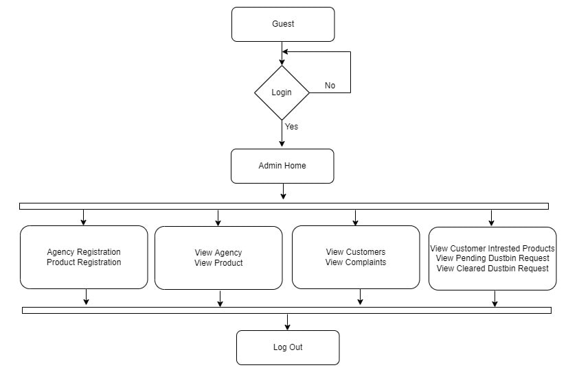
WORK FLOW OF ADMIN

Slide 14
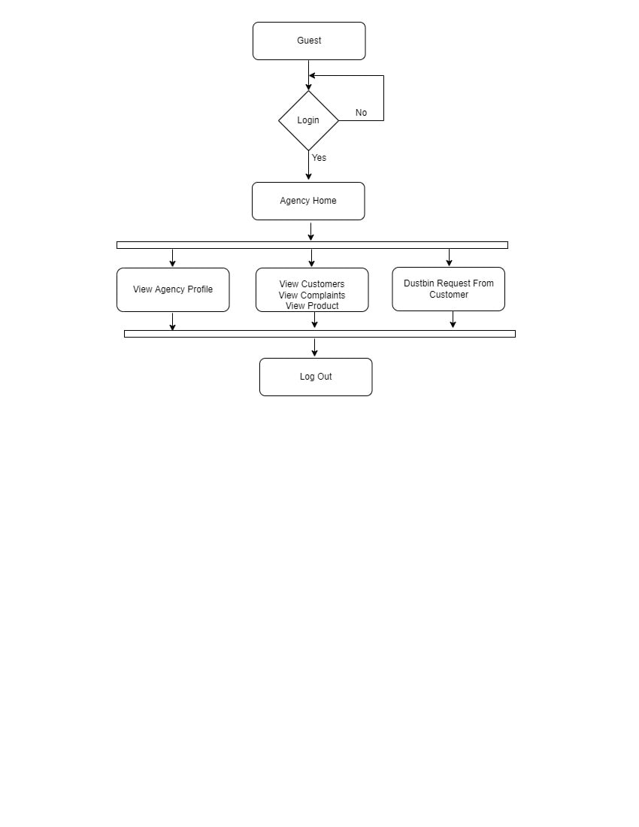
WORK FLOW OF AGENCY

Slide 15
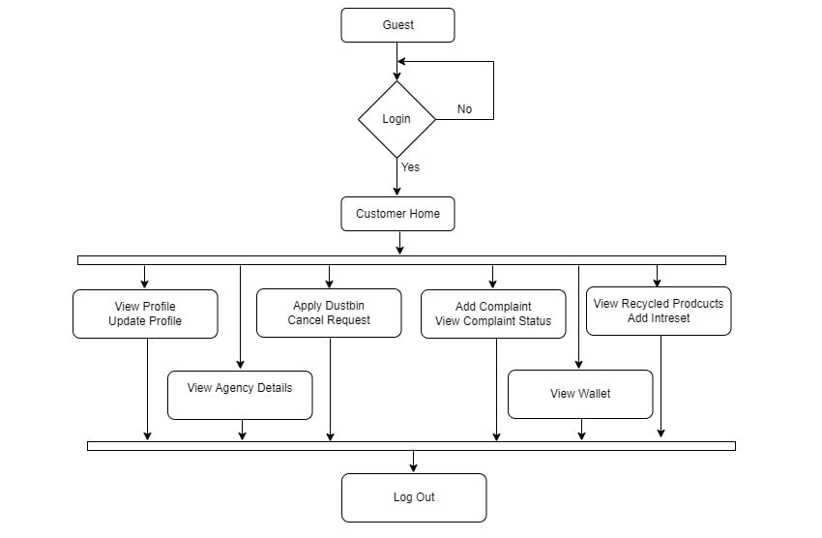
WORK FLOW OF USER

Slide 16
TABLES
tbl_Agency
tbl_Customer
tbl_Ewaste
tbl_Complaints
tbl_Product

Slide 17
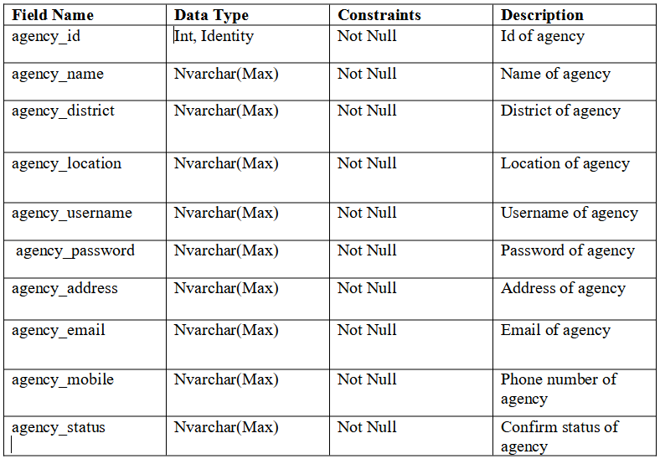
1.tbl_Agency

Slide 18
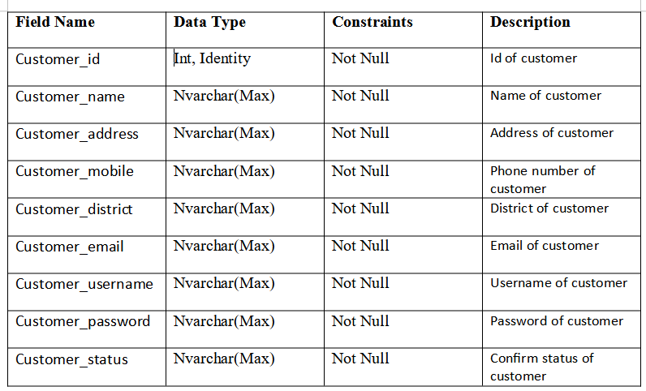
2.tbl_Customer

Slide 19
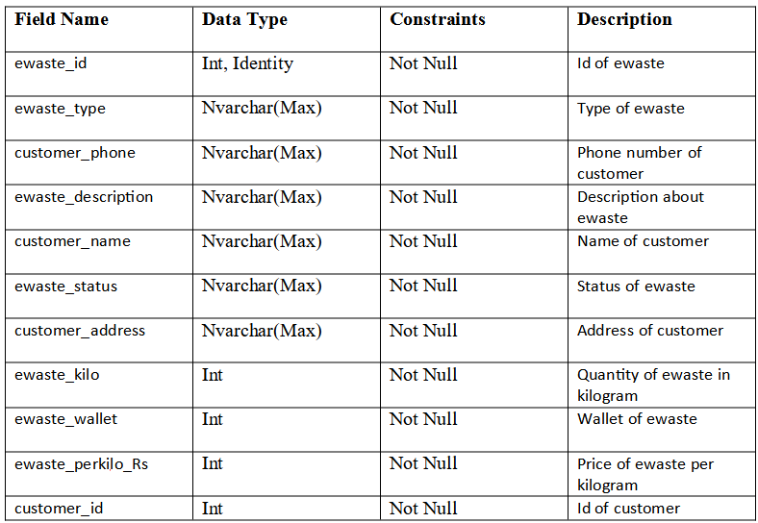
3.tbl_Ewaste

Slide 20
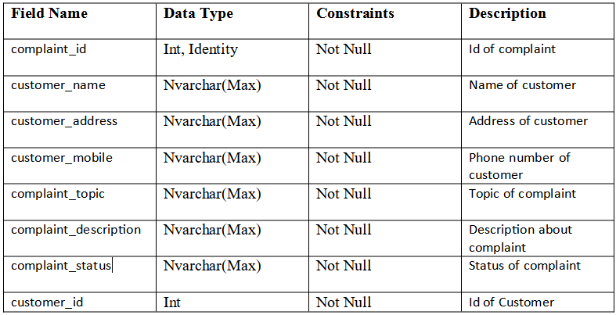
4.tbl_Complaints

Slide 21
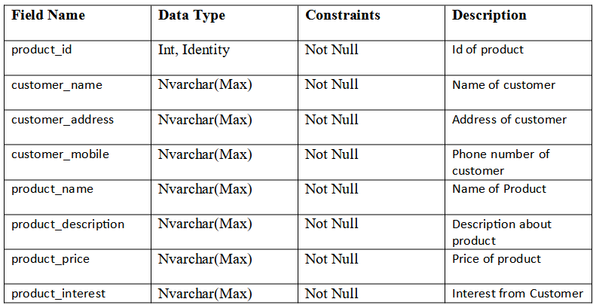
5.tbl_Product

Slide 22
CONCLUSION
Electronic and electrical equipment's cannot be avoided in today's world . So also is the case of waste electronic and electrical equipment . As long as this is a necessary evil , it has to be best managed to minimize its adverse impacts on environment . Electronic waste piles are growing , as is their pollution potential . Most of these problems have their source in the development and design of the products concerned . Using this type of system we can conclude that using the methodology of Reduce , Reuse and Recycle ( 3R ) decrease the piles of electronic and electrical equipment , and make environment to be cleaned and healthy .

Slide 23

THANK YOU

